Slide 1
Toxic comment classification
Julia Kiczka, Kasia Stasińska, Michał Wilczkowski, Szymon Majewski

Slide 2
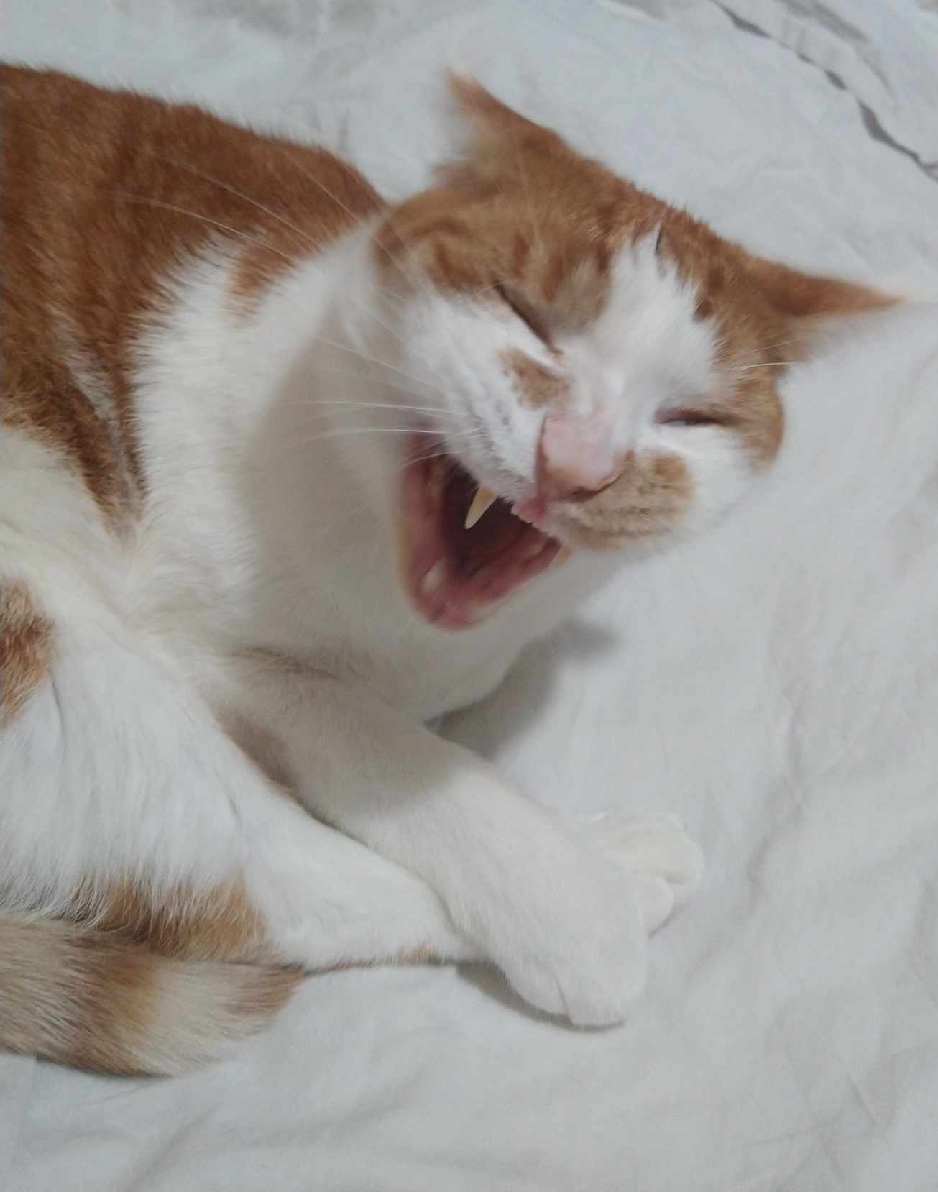
Data:
Toxic
Severe_toxic
Obscene
Threat
Insult
Identity_hate
https://www.kaggle.com/datasets/julian3833/jigsaw-toxic-comment-classification-challenge

Slide 3
What does gingerbread have to do with a fan?

Slide 4

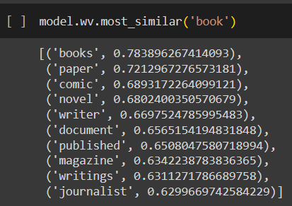
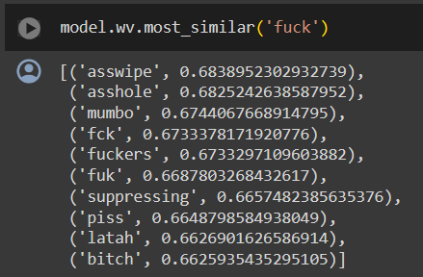

Slide 5
What words are toxic and occur the most?

Slide 6
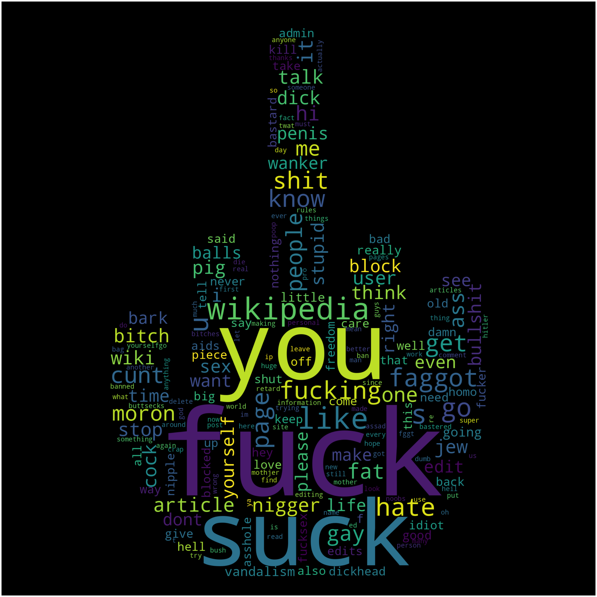

Slide 7
Which words are the most common in each toxicity class? What are the words that describe each label best?

Slide 8
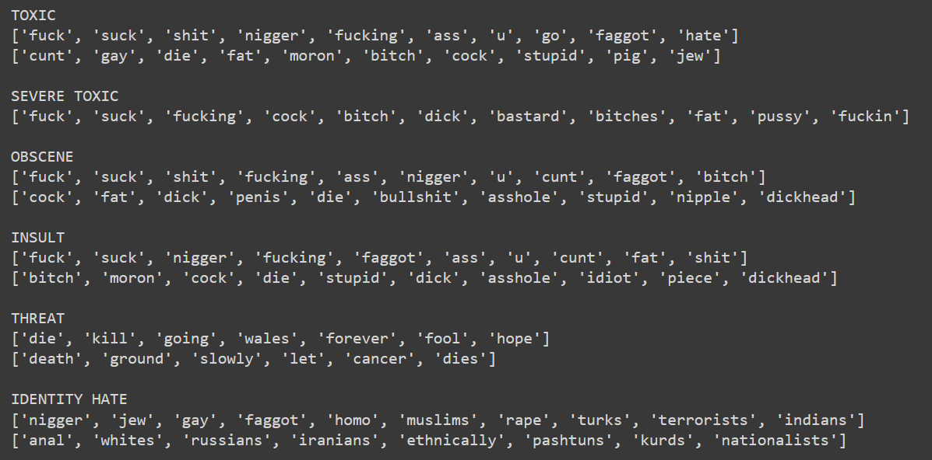
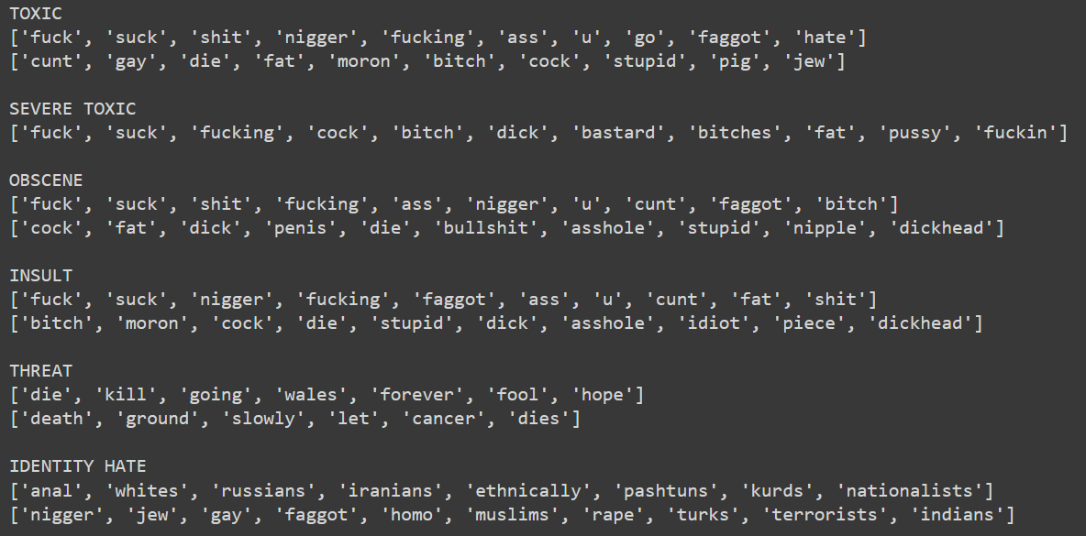

Slide 9
Is the numer of words a good classifier?

Slide 10
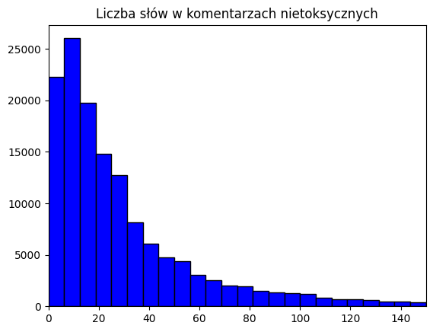
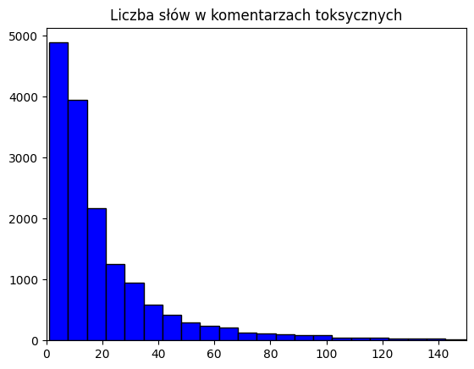

Slide 11
Summary
Accuracy
Weighted F1-score
Logistic regression: 0.80
Random forest: 0.77
KNN: 0.78
Xgboost: 0.79

Slide 12
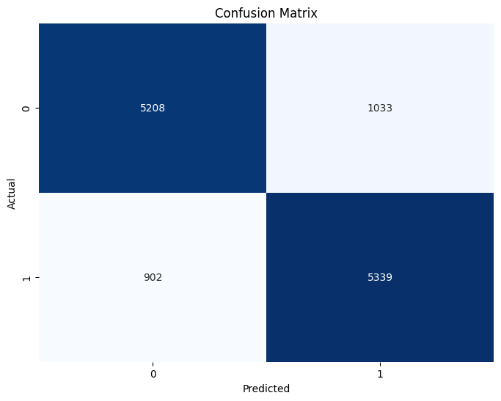

Slide 13
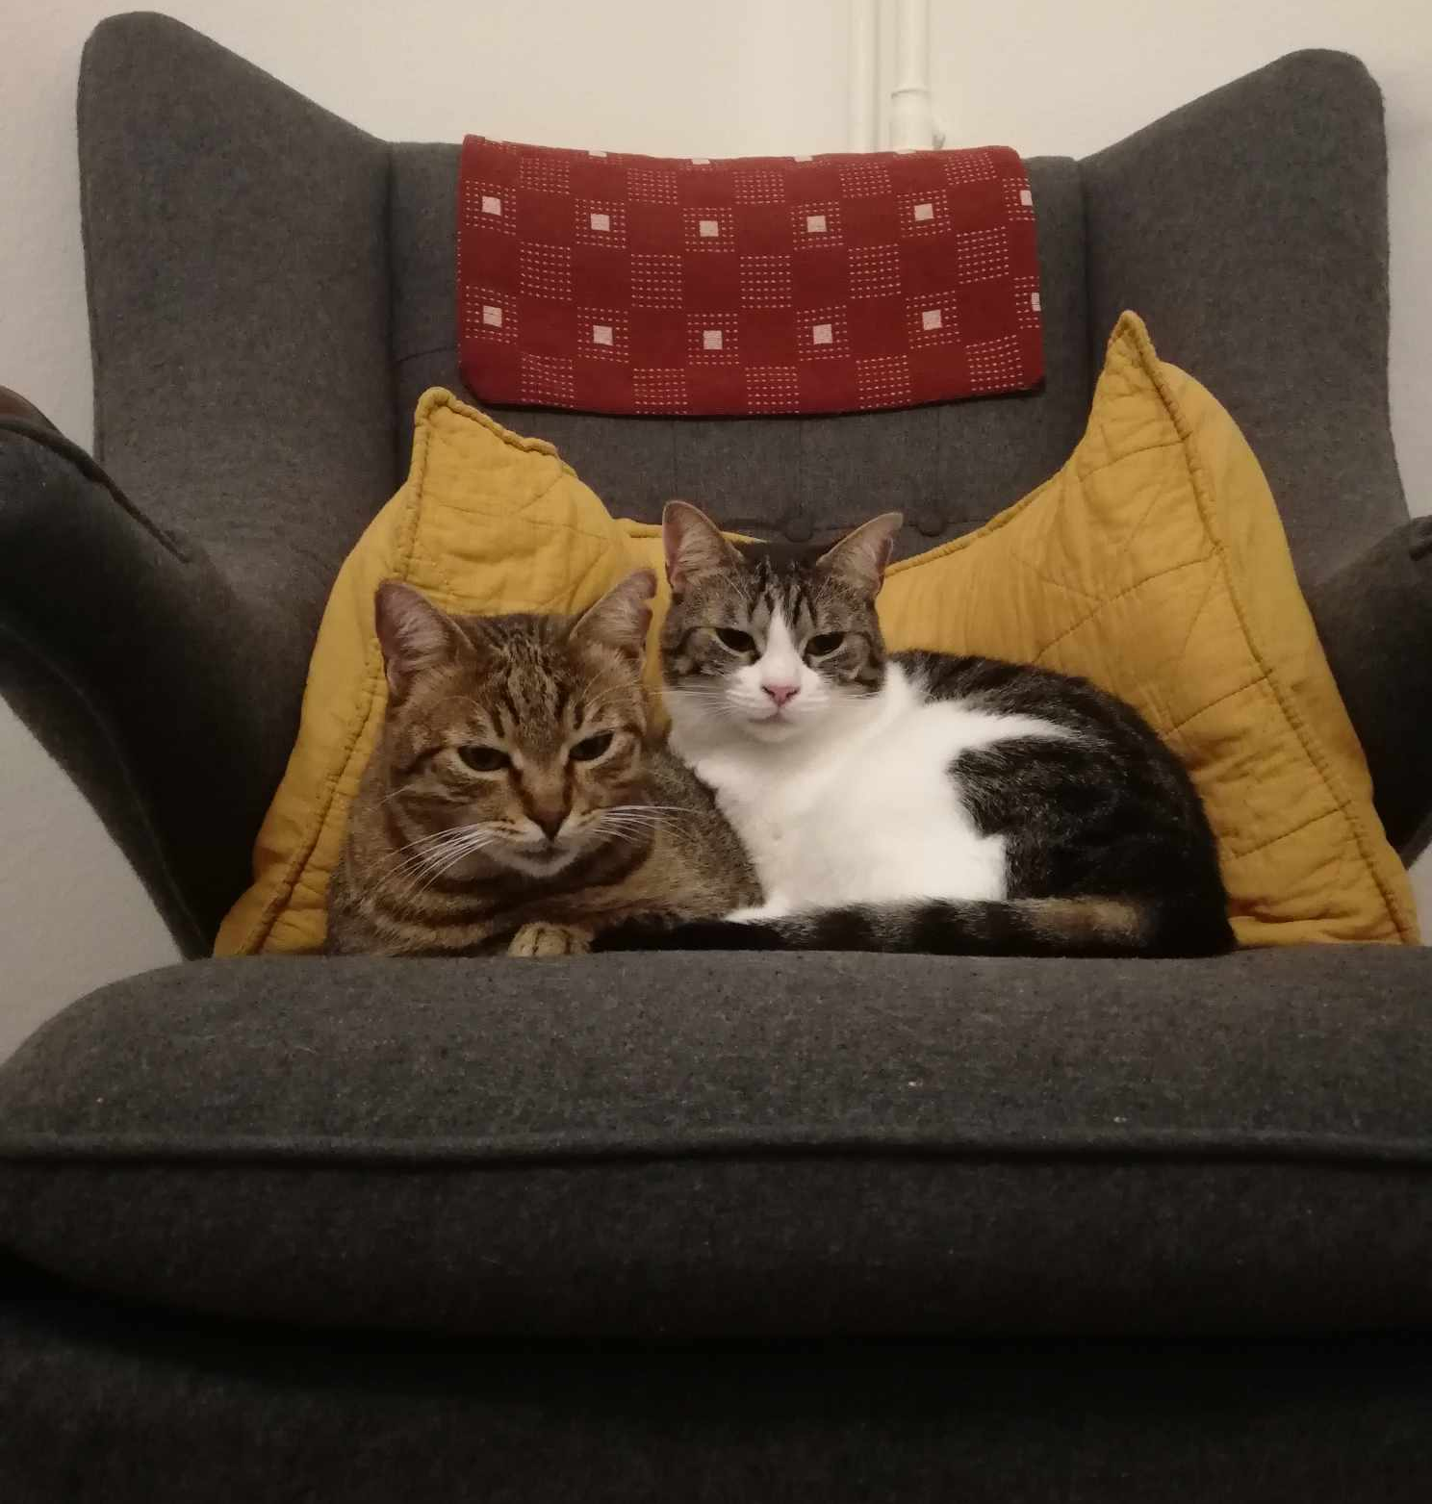
Thanks for your attention :PP
https://colab.research.google.com/drive/1592DxIuu_g_qbJ03mVKJ6LiC00enek19?usp=sharing#scrollTo=C0tH142k0N_h

